Slide 1
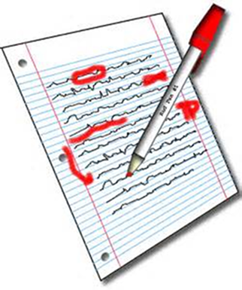
WALT: to tell the time to the nearest five minutes on analogue clocks
(past times)

Slide 2
Starter
Try these questions on your whiteboard:
4 x ? =28
4 x ? = 44
4 x ? = 36
4 x ? = 16
I go to the shop and buy 6 cartons of eggs. I now have 24 eggs altogether, how many eggs are there in each carton?

Slide 3
WALT: to tell the time to the nearest five minutes on analogue clocks
(past times)

Slide 4
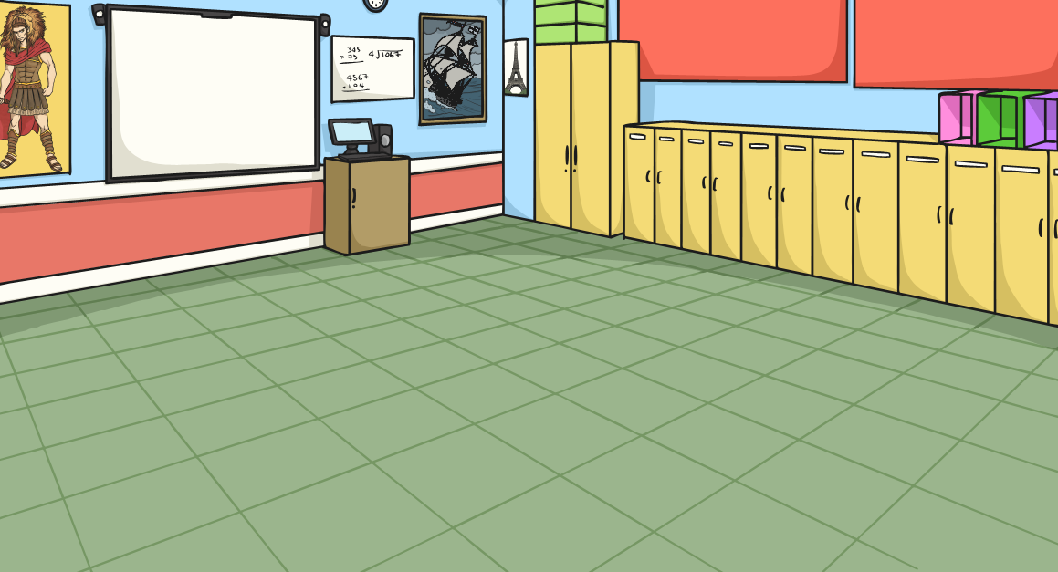
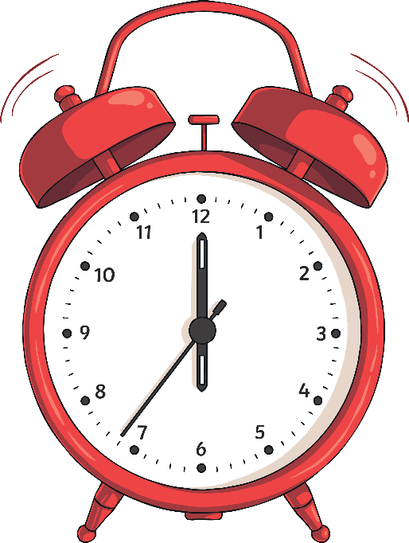
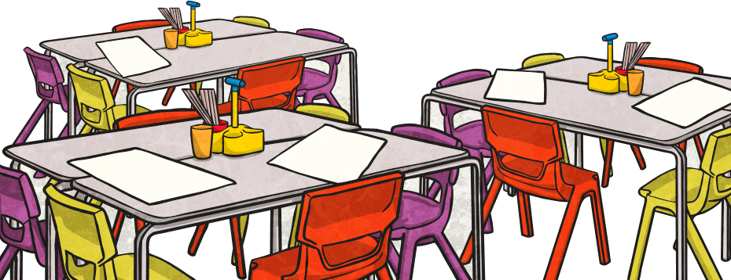
O’Clock, Half Past,
Quarter Past, Quarter To
Look at the times on the next screen. Draw a clock and hands to show each time.

Slide 5
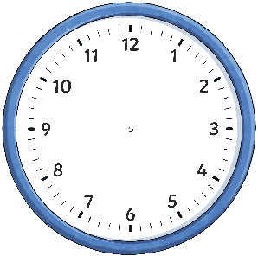
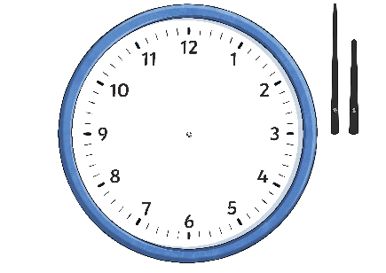
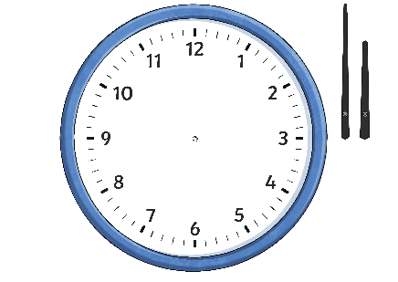
O’Clock, Half Past,
Quarter Past, Quarter To
Draw a clock and hands to show each time.
Click on the times to reveal the answers.
5 o’clock
Half Past
7
Quarter Past 1
Quarter
To 11
Half Past 10
Quarter
To 3
Quarter Past 10
6 o’clock
Quarter Past 7
Half Past 11
Quarter
To 2
3 o’clock

Slide 6
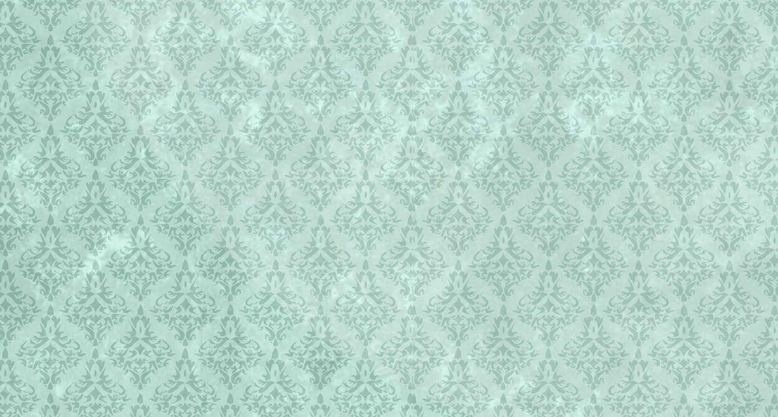
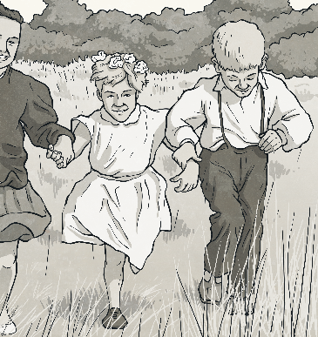

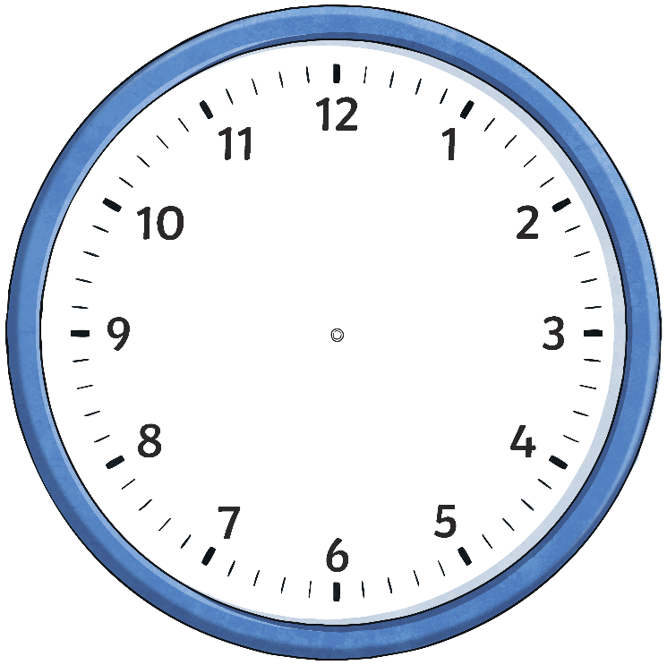
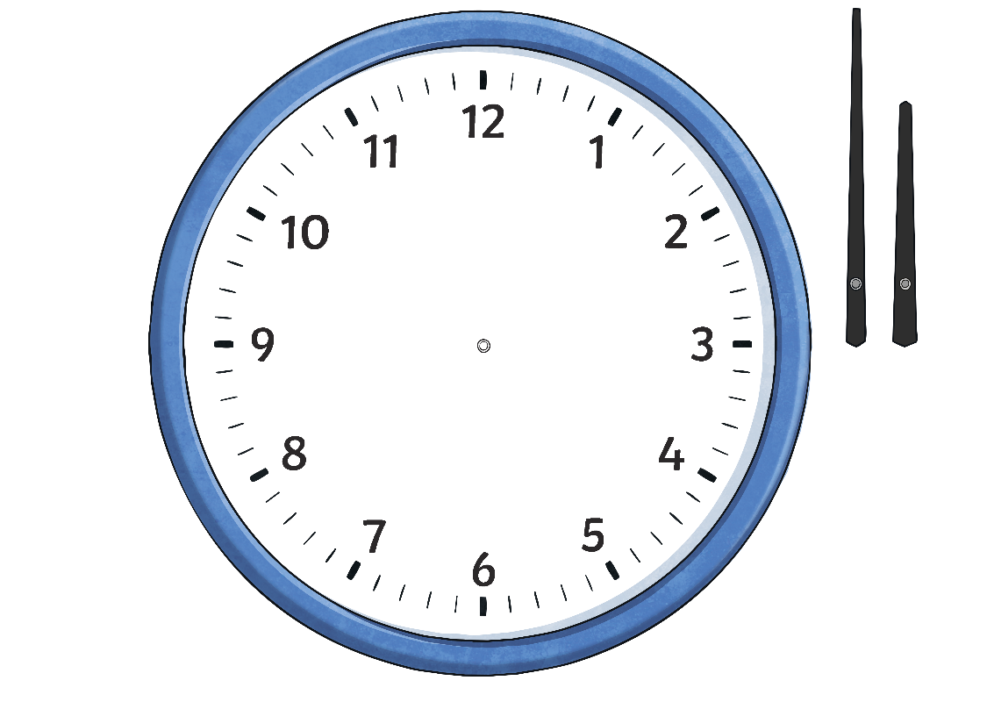
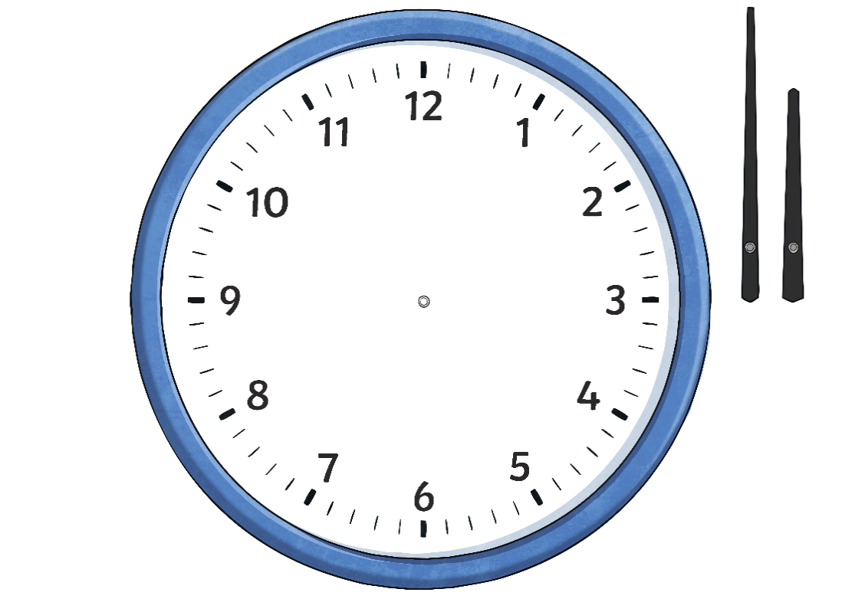
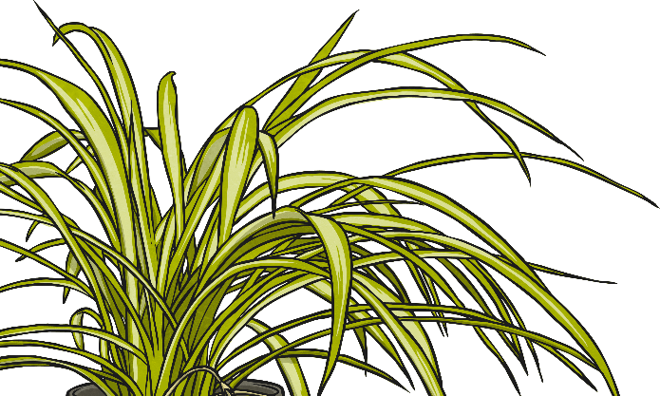
Telling the Time Past the Hour
Starting at 12, we count clockwise round the clock to tell us
minutes past the hour.
5 past
10 past
15 minutes past
(quarter past)
20 past
25 past
30 minutes past
(half past)

Slide 7
Telling the Time Past the Hour
What time is it?
5 past
hide hint
hint
10 past
15 minutes past
(quarter past)
20 past
25 past
5 past 5
30 minutes past
(half past)

Slide 8
Telling the Time Past the Hour
What time is it?
5 past
hide hint
hint
10 past
15 minutes past
(quarter past)
20 past
25 past
10 past 9
30 minutes past
(half past)

Slide 9
Telling the Time Past the Hour
What time is it?
5 past
hide hint
hint
10 past
15 minutes past
(quarter past)
20 past
15 minutes past 11
(quarter
past 11)
25 past
30 minutes past
(half past)

Slide 10
Telling the Time Past the Hour
What time is it?
5 past
hide hint
hint
10 past
15 minutes past
(quarter past)
20 past
25 past
20 past 2
30 minutes past
(half past)

Slide 11
Telling the Time Past the Hour
What time is it?
5 past
hide hint
hint
10 past
15 minutes past
(quarter past)
20 past
25 past 12
25 past
30 minutes past
(half past)

Slide 12
Telling the Time Past the Hour
What time is it?
5 past
hide hint
hint
10 past
15 minutes past
(quarter past)
20 past
30 minutes past 9
(half past 9)
25 past
30 minutes past
(half past)

Slide 13
Draw the Clock Hands - Past the Hour
a) 5 past 8
The big hand points to the 1, the small hand points just after the 8.

Slide 14
Draw the Clock Hands - Past the Hour
b) 25 past 11
The big hand
points to the 5, the small hand points almost halfway between the
11 and 12.

Slide 15
Draw the Clock Hands - Past the Hour
c) quarter past 5
The big hand points to the 3, the small hand points a quarter of the way between the
5 and 6.

Slide 16
Draw the Clock Hands - Past the Hour
d) 20 past 7
The big hand points to the 4, the small hand points just before halfway between the
7 and 8.

Slide 17
Draw the Clock Hands - Past the Hour
e) 10 past 6
The big hand points to the 2, the small hand points just
past 6.

Slide 18
Draw the Clock Hands - Past the Hour
f) quarter past 1
The big hand
points to the 3, the small hand points a quarter of the way between the 1 and the 2.

